Slide 1
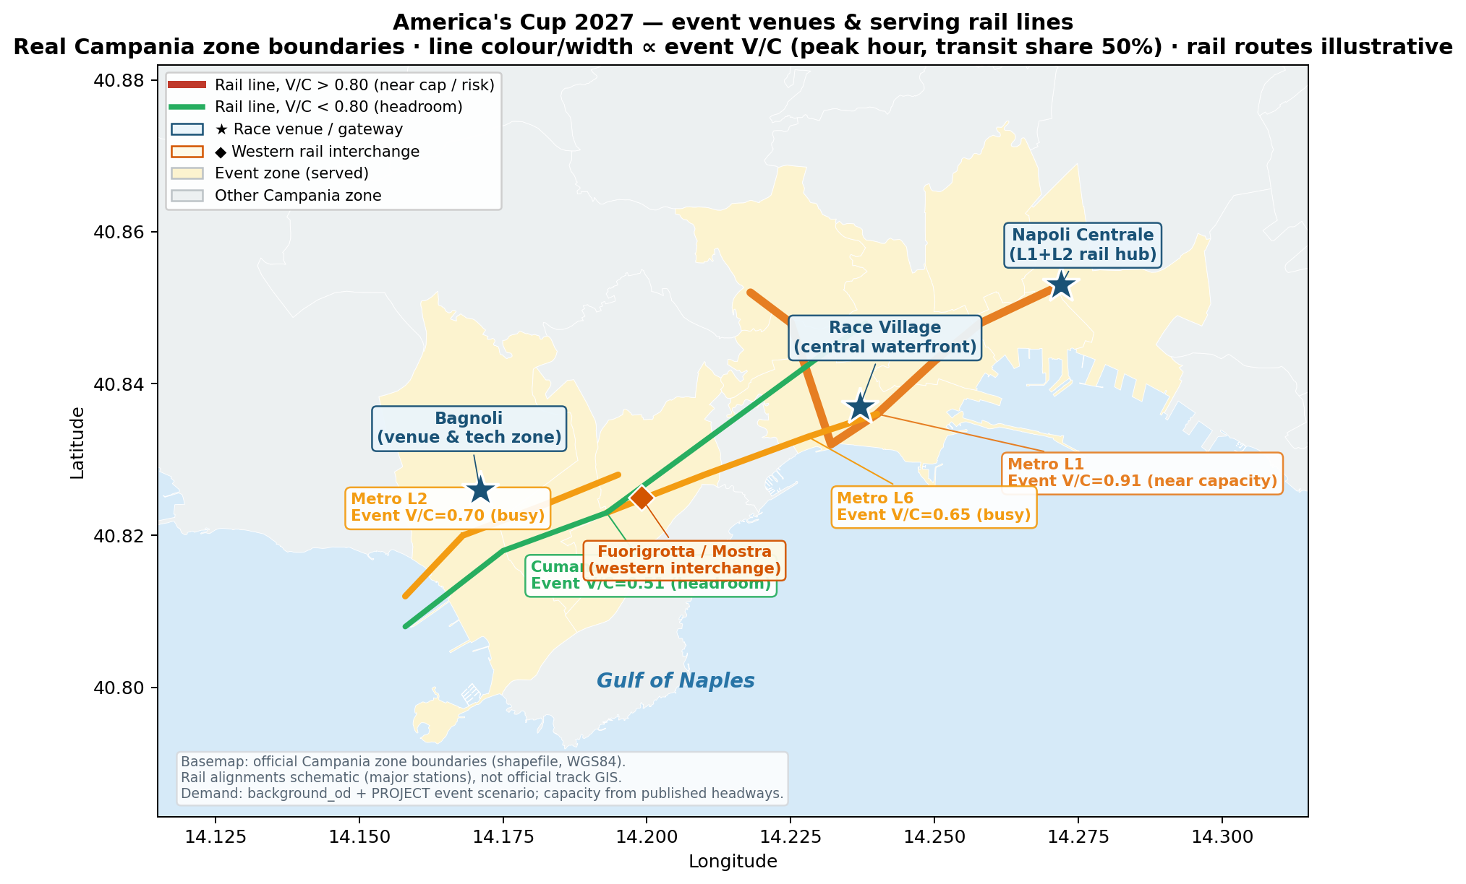
Can the rail network absorb the America's Cup?
Part B — Capacity & Saturation (V/C). Diagnosis only; mitigation = Services-improvement section.
Headline: NOT a capacity problem — a DISTRIBUTION problem.
• Metro Line 1 is the binding constraint: 0.71 → 0.91 at peak (event day), >1.0 at 60% transit share or under corridor concentration (1.20).
Demand growth into event zones:
• Region-wide +9.7%
• Event-day, 9 event zones +25%
• Steepest: Centro Direzionale +74%, Race Village +45%
• The race venue (Bagnoli) is over-served — 3 lines, V/C only ~0.5–0.7.
Notes:
Not a total-capacity problem, a distribution problem. Bagnoli venue has 3 lines and spare capacity, but Metro Line 1 — central spine through Napoli Centrale — is the binding constraint: 0.71 to 0.91 on an event day, over 1.0 at 60% transit share or under corridor concentration (1.20).

Slide 2
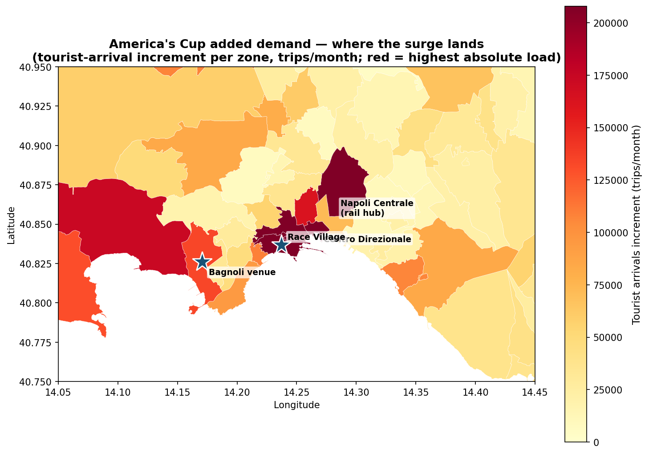
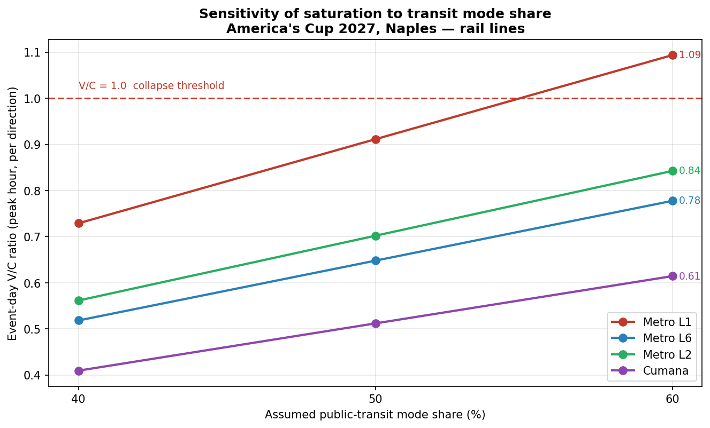
Saturation concentrates on the central spine — not the venue
• Choropleth: added demand lands on central Naples / Napoli Centrale; the venue is lighter. Sensitivity: only L1 crosses 1.0 (at 60%).
Notes:
Left: choropleth on real zone boundaries — added demand concentrates in central Naples and the gateway; the venue absorbs less. Right: sensitivity — only Line 1 crosses 1.0, only at 60% transit share, so the conclusion is robust to the assumption.

Slide 3
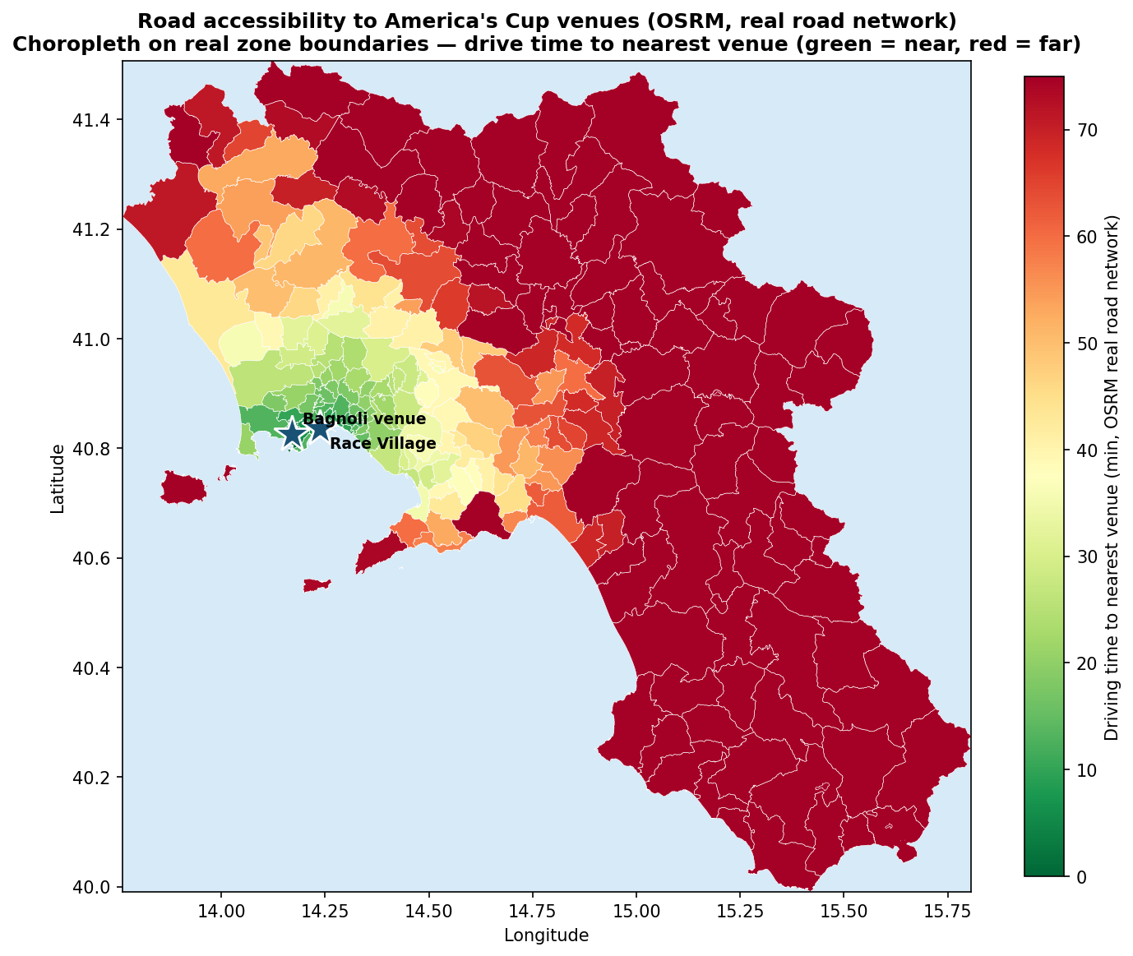
Where demand comes from (OSRM) + conclusion
Road accessibility (my OSRM 222×222 real-road time matrix):
• 71% of Campania-origin tourist demand is within a 45-min drive (mean 41 min) → Naples-centred → confirms central L1 pressure.
• ~21% comes from >60 min away (Salerno/Cilento) → relies on road approaches + regional rail.
Conclusion
• Total capacity is sufficient (~24,000 pax/h/dir) — the issue is its distribution.
• → Target relief on L1 / Napoli Centrale (peak frequency ↑, divert via Line 6).
• Concrete measures (shuttle bus) → Services-improvement section.
Notes:
OSRM accessibility: 71% within a 45-min drive (mean 41 min) — Naples-centred, why the central corridor takes the pressure. ~21% from beyond 60 min leans on regional rail. Conclusion: distribution problem, not shortfall — target Line 1 and the gateway. Mitigation (shuttle bus) is the Services-improvement part.

